Slide 1


Module 3 : Lecture 1
Java Basics
Andrei Kliashchonak
December 17, 2015

Slide 2
Module 3 : Agenda
1
2
3
Lecture 1
Lecture 2
Lecture 3
Overview
Type of data
Operators and operations
Classes / structures
Base API
OOP
Java Collection Framework
Input/Output streams
Exceptions
Enums

Slide 3
Java overview

Slide 4
JAVA
1
Language
2
Platform
3
Technology / Technology Stack
…
etc.

Slide 5
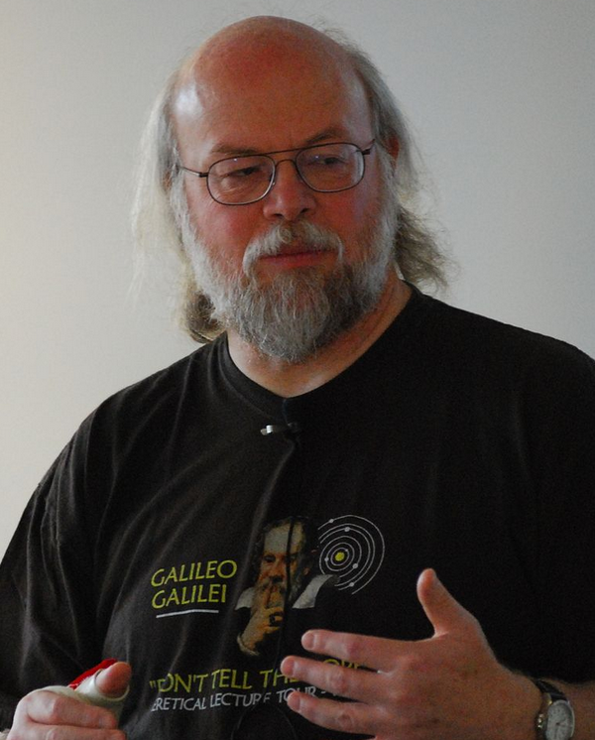
History
James Arthur Gosling
It must be "simple, object-oriented, and familiar"
It must be "robust and secure"
It must be "architecture-neutral and portable"
It must execute with "high performance"
It must be "interpreted, threaded, and dynamic"
Born May 19, 1955.
Is a Canadian computer scientist, best known as the father of the Java programming language
1991 – начало работы,
первая версия – Oak
1997 – Java 1.1
2001 – Java2 1.4
2011 – Java 7
2000 – Java2 1.3
2014 – Java 8
1999 – Java 1.2 (Java2)
2006 – Java 6
2004 – Java 5.0

Slide 6
Principles and features
1
Object-Oriented
2
Platform independent
3
Simple
4
Secure
5
Architectural-neutral
6
Portable
7
Robust
8
Multithreaded
9
Interpreted
10
High Performance

Slide 7
Usage areas
Java ME
Micro Edition
provides a robust, flexible environment for applications running on embedded and mobile devices in the Internet of Things: micro-controllers, sensors, gateways, mobile phones, personal digital assistants (PDAs), TV set-top boxes, printers and more.
1
Java SE
Standard Edition
lets you develop and deploy Java applications on desktops and servers, as well as in today's demanding embedded environments. Java offers the rich user interface, performance, versatility, portability, and security that today's applications require.
2
Java EE
Enterprise Edition
is the standard in community-driven enterprise software. Java EE is developed using the Java Community Process, with contributions from industry experts, commercial and open source organizations, Java User Groups, and countless individuals. Each release integrates new features that align with industry needs, improves application portability, and increases developer productivity.
3

Slide 8
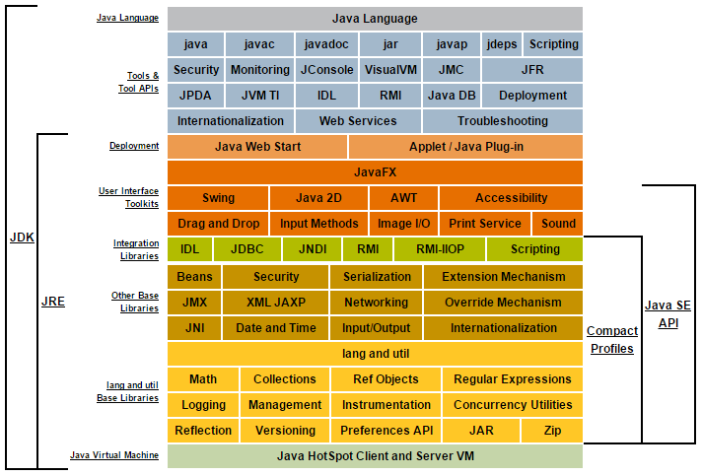
Java Conceptual Diagram
OpenJDK
Notes:
P37 – divide into 2 slides

Slide 9
Demo : “Hello World”

Slide 10
Java program execution
1
2

Slide 11
Real world : IDE
1
1
Intellij IDEA
2
Eclipse
3
NetBeans
…
etc.

Slide 12
Source file (.java)
If “package” statement exists, it must be first
If “import” statement exists, it must be only between “package” and first class declaration
Source file should have only one public class
If file have declaration of two or more classes, file name should have same name as public class

Slide 13
Java syntax

Slide 14
Lexical Structure
1
Whitespaces
2
Comments
3
Keywords
4
Identifiers
5
Literals
6
Operators
7
Delimiters

Slide 15
Whitespaces / Separators
ASCII SP character, also known as "space“
ASCII HT character, also known as "horizontal tab“
ASCII FF character, also known as "form feed"
ASCII LF character, also known as "newline"
ASCII CR character, also known as "return“
ASCII CR character followed by the ASCII LF character

Slide 16
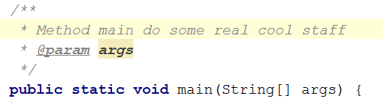
Comments
One-line comments :
Multiline comments :

Slide 17
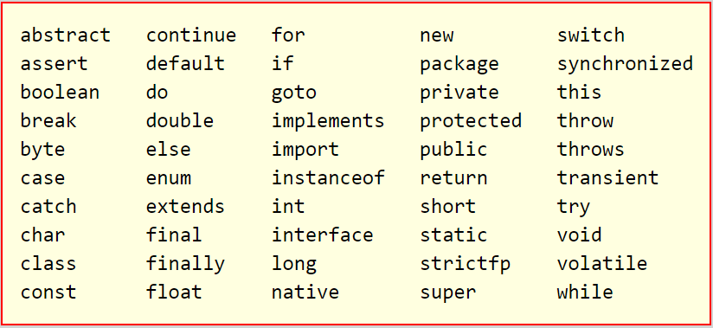
Keywords

Slide 18
Identifiers
A-Z (\u0041-\u005a)
a-z (\u0061-\u007a)
ASCII underscore (_, or \u005f) and dollar sign ($, or \u0024)
ASCII digits 0-9 (\u0030-\u0039)
!!! Cannot start from digits !!!
!!! Cannot start from NullLiteral or BooleanLiterals !!!
!!! Cannot be any of keywords !!!
!!! Case Sensitive !!!

Slide 19
Literals
Integer Literal : 10, 0xC0B0L, 07, 234L, 12l, 0b1011, 1_000_000
FloatingPoint Literal : 2.5, .02, 5E10, 2e+4, 4.1F, 2.1D, 6.022137e+23f
Boolean Literal : true, false
Character Literal : ‘A’, ‘@’, ‘%’, ‘#’, ‘\u1111’, '\uFFFF‘, ‘\’’, ‘\\’, ‘\t’
String Literal : “\”12”, “\n 0_o \n”, “double”, “false”
Null Literal : null

Slide 20
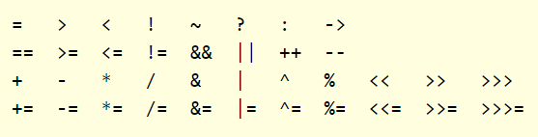
Operators
Java provides a rich set of operators to manipulate variables. We can divide all the Java operators into the following groups:
Arithmetic Operators
Relational Operators
Bitwise Operators
Logical Operators
Assignment Operators

Slide 21
The Arithmetic Operators
Arithmetic operators are used in mathematical expressions in the same way that they are used in algebra.
The following table lists the arithmetic operators.
Assume integer variable A holds 10 and variable B holds 20, then
Operator | Example
+ ( Addition ) | Adds values on either side of the operator Example: A + B will give 30
- ( Subtraction ) | Subtracts right hand operand from left hand operand Example: A - B will give -10
* ( Multiplication ) | Multiplies values on either side of the operator Example: A * B will give 200
/ (Division) | Divides left hand operand by right hand operand Example: B / A will give 2
% (Modulus) | Divides left hand operand by right hand operand and returns remainder Example: B % A will give 0
++ (Increment) | Increases the value of operand by 1 Example: B++ gives 21
-- ( Decrement ) | Decreases the value of operand by 1 Example: B-- gives 19

Slide 22
The Relational Operators
There are following relational operators supported by Java language
Assume variable A holds 10 and variable B holds 20, then:
Operator | Example
== (equal to) | Checks if the values of two operands are equal or not, if yes then condition becomes true. Example: (A == B) is not true.
!= (not equal to) | Checks if the values of two operands are equal or not, if values are not equal then condition becomes true. Example: (A != B) is true.
> (greater than) | Checks if the value of left operand is greater than the value of right operand, if yes then condition becomes true. Example: (A > B) is not true.
< (less than) | Checks if the value of left operand is less than the value of right operand, if yes then condition becomes true. Example: (A < B) is true.
>= (greater than or equal to) | Checks if the value of left operand is greater than or equal to the value of right operand, if yes then condition becomes true. Example (A >= B) is not true.
<= (less than or equal to) | Checks if the value of left operand is less than or equal to the value of right operand, if yes then condition becomes true. example(A <= B) is true.

Slide 23
The Bitwise Operators
Java defines several bitwise operators, which can be applied to the integer types, long, int, short, char, and byte.
Bitwise operator works on bits and performs bit-by-bit operation.
Assume if A = 60; and B = 13; now in binary format they will be as follows:
a = 0011 1100; and b = 0000 1101
Operator | Example
& (bitwise and) | Binary AND Operator copies a bit to the result if it exists in both operands. Example: (A & B) will give 12 which is 0000 1100
| (bitwise or) | Binary OR Operator copies a bit if it exists in either operand. Example: (A | B) will give 61 which is 0011 1101
^ (bitwise XOR) | Binary XOR Operator copies the bit if it is set in one operand but not both. Example: (A ^ B) will give 49 which is 0011 0001
~ (bitwise compliment) | Binary Ones Complement Operator is unary and has the effect of 'flipping' bits. Example: (~A ) will give -61 which is 1100 0011 in 2's complement form due to a signed binary number.
<< (left shift) | Binary Left Shift Operator. The left operands value is moved left by the number of bits specified by the right operand Example: A << 2 will give 240 which is 1111 0000
>> (right shift) | Binary Right Shift Operator. The left operands value is moved right by the number of bits specified by the right operand. Example: A >> 2 will give 15 which is 1111
>>> (zero fill right shift) | Shift right zero fill operator. The left operands value is moved right by the number of bits specified by the right operand and shifted values are filled up with zeros. Example: A >>>2 will give 15 which is 0000 1111

Slide 24
The Logical Operators
The following table lists the logical operators.
Assume Boolean variables A holds true and variable B holds false, then:
Operator | Example
&& (logical and) | Called Logical AND operator. If both the operands are non-zero, then the condition becomes true. Example (A && B) is false.
|| (logical or) | Called Logical OR Operator. If any of the two operands are non-zero, then the condition becomes true. Example (A || B) is true.
! (logical not) | Called Logical NOT Operator. Use to reverses the logical state of its operand. If a condition is true then Logical NOT operator will make false. Example !(A && B) is true.

Slide 25
The Assignment Operators
There are following assignment operators supported by Java language:
Operator | Example
= | Example: C = A + B will assign value of A + B into C
+= | Example: C += A is equivalent to C = C + A
-= | Example:C -= A is equivalent to C = C - A
*= | Example: C *= A is equivalent to C = C * A
/= | ExampleC /= A is equivalent to C = C / A
%= | Example: C %= A is equivalent to C = C % A
<<= | ExampleC <<= 2 is same as C = C << 2
>>= | Example C >>= 2 is same as C = C >> 2
&= | Example: C &= 2 is same as C = C & 2
^= | Example: C ^= 2 is same as C = C ^ 2
|= | Example: C |= 2 is same as C = C | 2

Slide 26
Precedence of Java Operators
Operator precedence determines the grouping of terms in an expression. This affects how an expression is evaluated.
Certain operators have higher precedence than others; for example, the multiplication operator has higher precedence than the addition operator:
For example, x = 7 + 3 * 2; here x is assigned 13.
Operators with the highest precedence appear at the top of the table, those with the lowest appear at the bottom. Within an expression, higher precedence operators will be evaluated first.
Category | Operator | Associativity
Postfix | () [] . (dot operator) | Left toright
Unary | ++ -- ! ~ | Right to left
Multiplicative | * / % | Left to right
Additive | + - | Left to right
Shift | >> >>> << | Left to right
Relational | > >= < <= | Left to right
Equality | == != | Left to right
Bitwise AND | & | Left to right
Bitwise XOR | ^ | Left to right
Bitwise OR | | | Left to right
Logical AND | && | Left to right
Logical OR | || | Left to right
Conditional | ?: | Right to left
Assignment | = += -= *= /= %= >>= <<= &= ^= |= | Right to left
Comma | , | Left to right

Slide 27
Java data-types,
Variables

Slide 28
Data Types
Primitive (basic) data types
Reference data types
null

Slide 29

Primitive Types
byte
8
short
16
int
32
long
64
float
32
double
64
number
decimal
char
16
boolean
8
character
logical

Slide 30
Primitive Types
Type | Size (bits) | Default value | Values range
boolean | 8 | false | true, false
byte | 8 | 0 | -128 … 127
char | 16, 32 | ‘\u0000’ | 0 … 65535
short | 16 | 0 | -32768 … 32767
int | 32 | 0 | -2147483648 … 2147483647
long | 64 | 0L | 922372036854775807L
float | 32 | 0.0 | 3.40282347E+38
double | 64 | 0.0 | 1.797693134486231570E+308

Slide 31

Variables / Variables assignment
You must declare all variables before they can be used. The basic form of a variable declaration is shown here:
type identifier [=value] [, identifier [=value] … ];
Following are valid examples of variable declaration and initialization in Java:

Slide 32
Kinds of Variables in Java
Local variables
Instance variables
Class/static variables

Slide 33
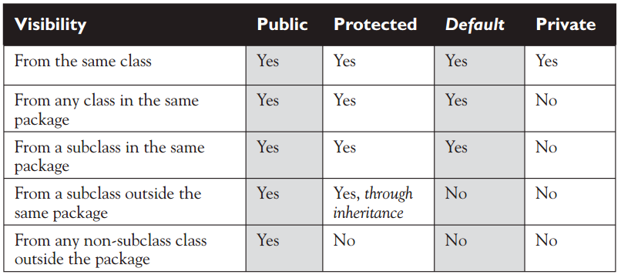
Modifiers
Access Control Modifiers:
Non-Access Modifiers:
static
final
abstract

Slide 34
Control
Operators

Slide 35
Control Operators and Statements in Java
“Decision Making”
operators
if-else
switch
“Loop”
operators
‘for’ loop
‘while’ loop
Loop
Control Statements
return
‘do…while’ loop
break
continue
The : ? operator

Slide 36
“Decision Making” operators
Following is the general form of a typical decision making structure found in most of the programming languages:
Java programming language provides following types of decision making statements.
Statement | Description
if statement | An if statement consists of a boolean expression followed by one or more statements.
if...else statement | An if statement can be followed by an optional else statement, which executes when the boolean expression is false.
nested if statements | You can use one if or else if statement inside another if or else if statement(s).
switch statement | A switch statement allows a variable to be tested for equality against a list of values.
condition
If condition is TRUE
If condition is FALSE
Conditional Code
Non-conditional code

Slide 37

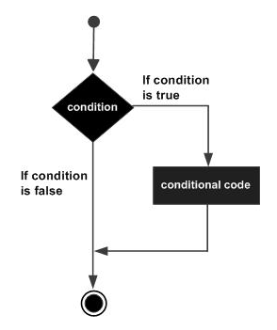
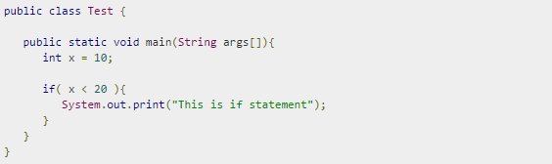
“Decision Making” operators: if
if statement
An if statement consists of a Boolean expression followed by one or more statements.
Syntax:
Flow diagram:
A sample:

Slide 38

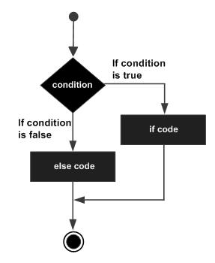
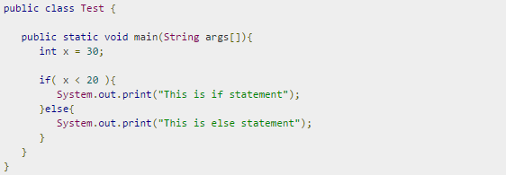
“Decision Making” operators: if…else
if…else statement
An if statement can be followed by an optional else statement, which executes when the Boolean expression is false.
Syntax:
Flow diagram:
A sample:

Slide 39

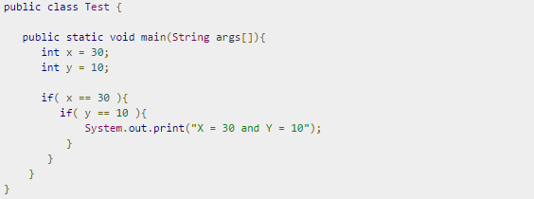
“Decision Making” operators: nested if/if…else
nested if / if…else statement
It is always legal to nest if-else statements which means you can use one if or else if statement inside another if or else if statement.
Syntax:
A sample:

Slide 40
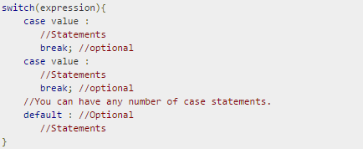
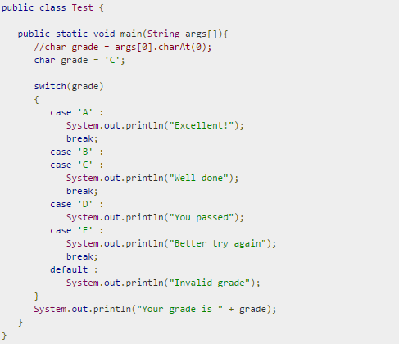
“Decision Making” operators: switch
switch statement
A switch statement allows a variable to be tested for equality against a list of values. Each value is called a case, and the variable being switched on is checked for each case.
Syntax:
A sample:

Slide 41
“Loop” Operators
A loop statement allows us to execute a statement or group of statements multiple times and following is the general form of a loop statement in most of the programming languages:
Java programming language provides the following types of loop to handle looping requirements
Loop Type | Description
while loop | Repeats a statement or group of statements while a given condition is true. It tests the condition before executing the loop body.
for loop | Execute a sequence of statements multiple times and abbreviates the code that manages the loop variable.
switch statement | A switch statement allows a variable to be tested for equality against a list of values.
do...while loop | Like a while statement, except that it tests the condition at the end of the loop body
Conditional Code
If condition is TRUE
condition
If condition is FALSE

Slide 42

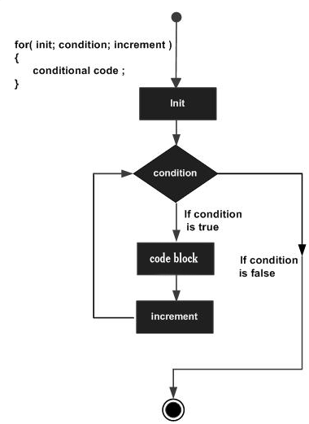
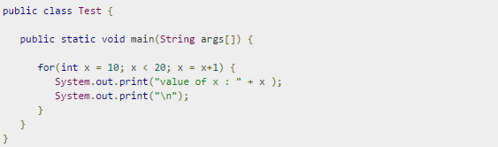
“Loop” Operators : ‘for’ loop
‘for’ loop
A for loop is a repetition control structure that allows you to efficiently write a loop that needs to execute a specific number of times.
A for loop is useful when you know how many times a task is to be repeated.
Syntax:
Flow diagram:
A sample:

Slide 43

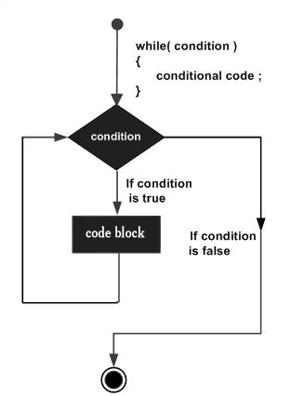
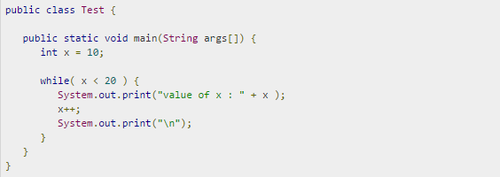
“Loop” Operators : ‘while’ loop
‘while’ loop
A while loop statement in java programming language repeatedly executes a target statement as long as a given condition is true.
Syntax:
Flow diagram:
A sample:

Slide 44

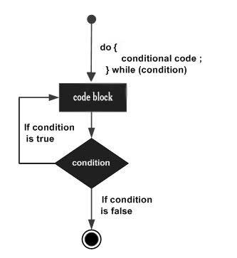
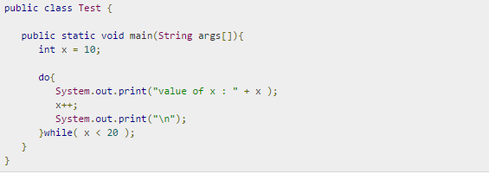
“Loop” Operators : ‘do…while’ loop
‘do…while’ loop
A do...while loop is similar to a while loop, except that a do...while loop is guaranteed to execute at least one time.
Syntax:
Flow diagram:
A sample:

Slide 45
Loop Control Statements
Loop control statements change execution from its normal sequence. When execution leaves a scope, all automatic objects that were created in that scope are destroyed.
Java supports the following control statements.
Control Statement | Description
break statement | Terminates the loop or switch statement and transfers execution to the statement immediately following the loop or switch.
continue statement | Causes the loop to skip the remainder of its body and immediately retest its condition prior to reiterating.

Slide 46
Classes

Slide 47
Classes & Objects
■ Class : A template that describes the kinds of state and behavior that objects of its type support.
■ Object : At runtime, when the Java Virtual Machine (JVM) encounters the new keyword, it will use the appropriate class to make an object which is an instance of that class. That object will have its own state, and access to all of the behaviors defined by its class.
■ State (instance variables) : Each object (instance of a class) will have its own unique set of instance variables as defined in the class. Collectively, the values assigned to an object's instance variables make up the object's state.
■ Behavior (methods) : When a programmer creates a class, she creates methods for that class. Methods are where the class' logic is stored. Methods are where the real work gets done. They are where algorithms get executed, and data gets manipulated.

Slide 48
Classes
class ClassName {
type instance_variable1;
type instance _variable2;
//...
type instance_variableN;
type methodname1(parameter-list) {
// method body
}
type methodname2 (parameter-list) {
// method body
}
//...
type methodnameN(parameter-list) {
// method body
}
}

Slide 49
Constructors
Constructor is a method that is automatically called during creation of an instance (object) of a class, and provides necessary actions for initialization of this object.
Constructor always has the same name as a class.
Constructor is uses only with a keyword ‘new’ during initialization of an object.
Constructor does not return any value. Constructor may have parameters.
Each class may have any number of constructors.

Slide 50
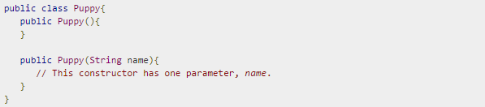
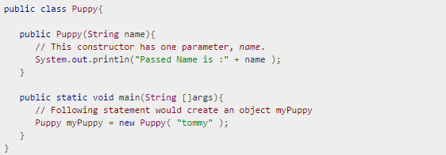
Constructors
A sample of constructors and creating an object:

Slide 51
Reference types
1. Object myObject1; 2. Object myObject2; 3. myObject1 = null; 4. myObject2 = new Object(); 5. myObject1 = myObject2;
HEAP
1
2
myObject1
myObject2
null

Slide 52
String
String greeting = “Hello ”;
String greeting = new String(“Hello”);
String helloWorld= “My” + “ “ + “World.”;
String greeting = helloWorld; // «My World.»
String greeting = “Hello ”;
String helloWorld= “My” + “ “ + “World.”;
String greeting += helloWorld; // «Hello My World.»
String str[] = { “one”, “two”, “three” };

Slide 53
String
equals()
toUpperCase()
toLowerCase()
split(‘separator’);
concat(“Another String”)
replace(‘r’, ‘R’)
comparing
changing register case
concatenating
replacing
splitting

Slide 54
Default streams

Slide 55
IN, OUT, ERR
System.out
Console (by default)
print(), println(), write()
System.in
Keyboard
(by default)
Scanner,
BufferedReader,
etc
System.err
Similar to System.out

Slide 56
Scanner
public static void main(String[] args) { Scanner scanner = new Scanner(System.in); String line = scanner.nextLine(); System.out.println(line); }

Slide 57
Demo

Slide 58
Question?

